Slide 1

TITLE : PRISM
Personalized Real-time Intelligent Support Module
Capgemini x Synchrony Hackathon Innovation
T4FP-2026
TEAM 7-TECH TITANS:
1.Charmi Reddy P
2. Malavika Manga
3. Aarthi Pasare
4. Nikhil Pabbu
5. Aranagi Sravan Kumar
MENTORS:
1.RAJESH NARAYAN
2.SIVA PRASHAD
3. AJAY GOUD

Slide 2
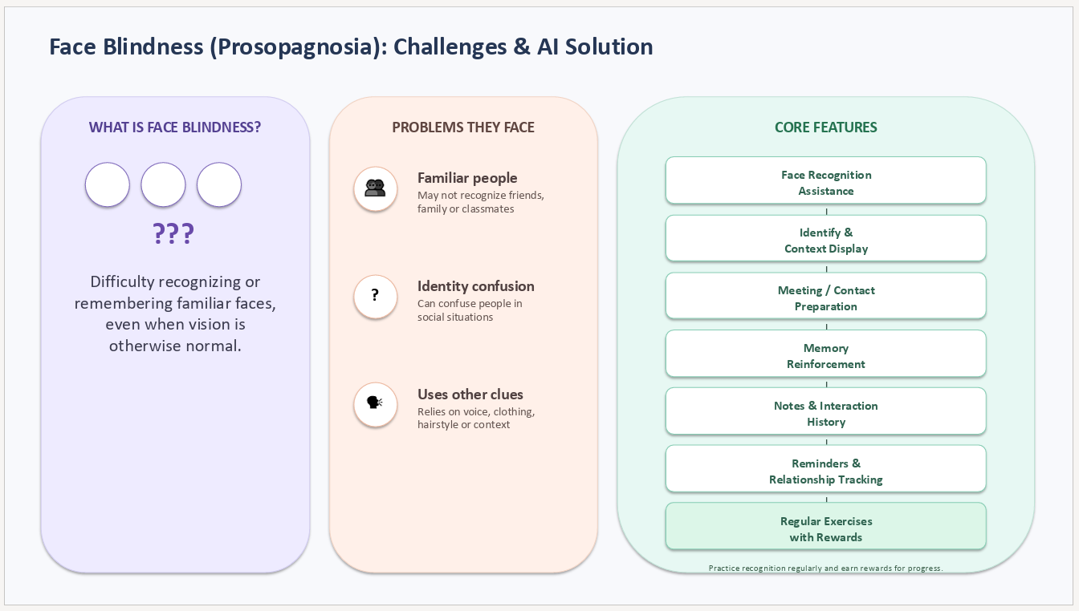

PROSOPAGNOSIA
DYSLEXIA
AUTISM
PROSOPAGNOSIA

Slide 3
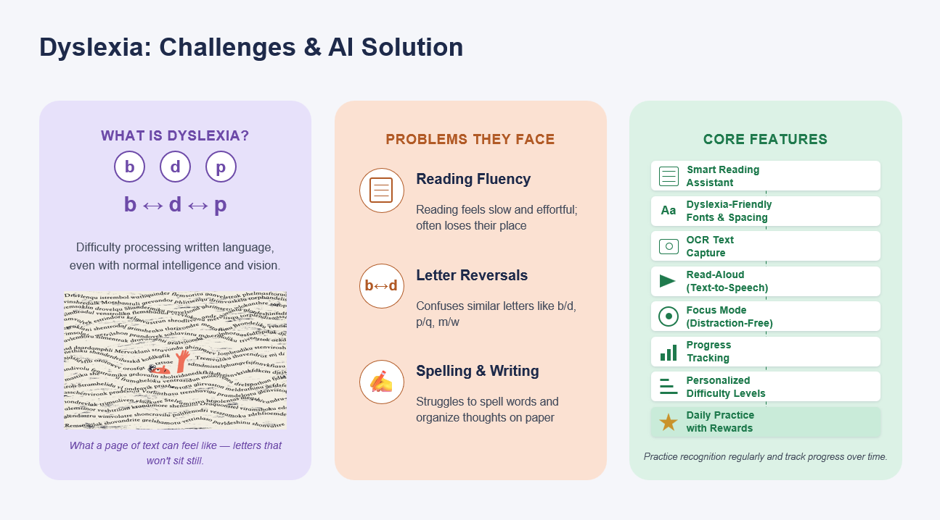
DYSLEXIA

Slide 4
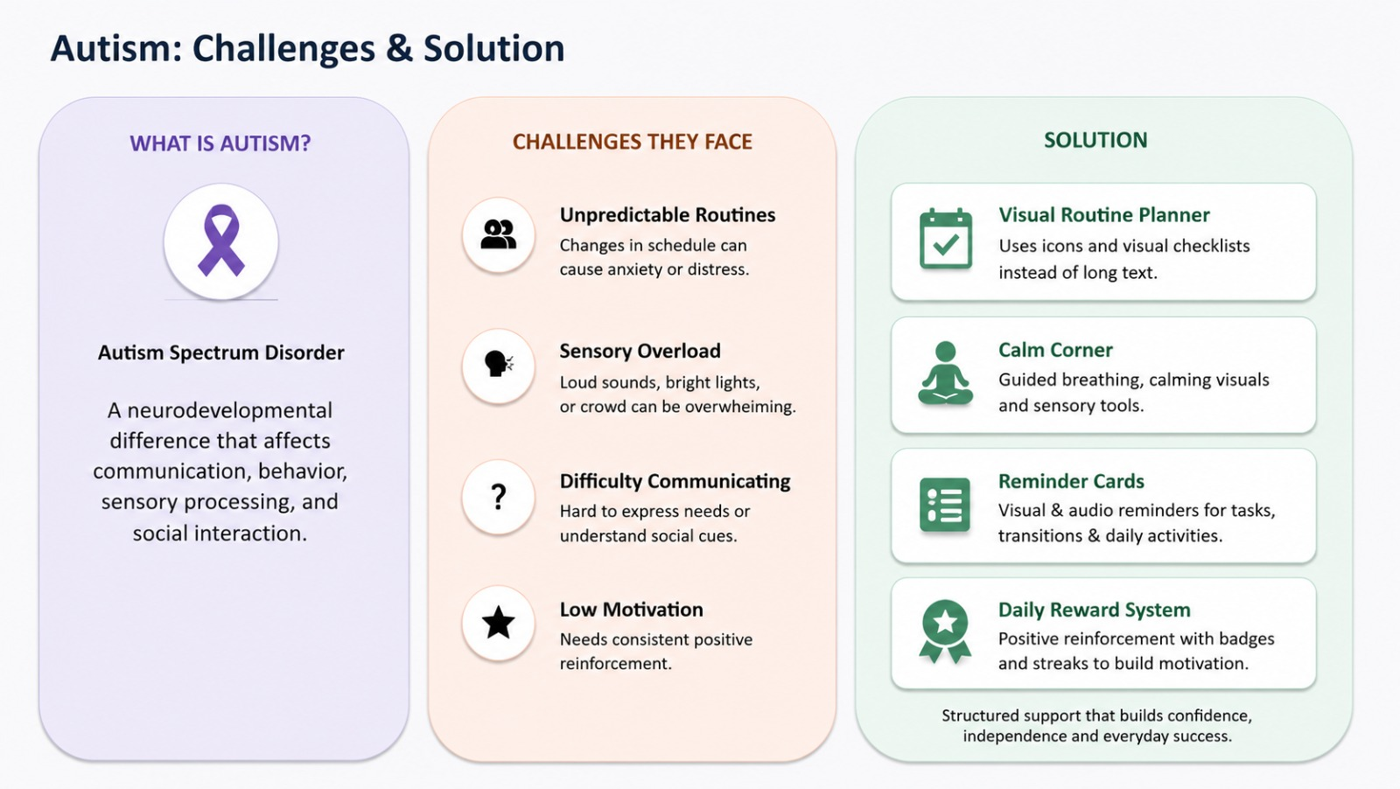
AUTISM

Slide 5
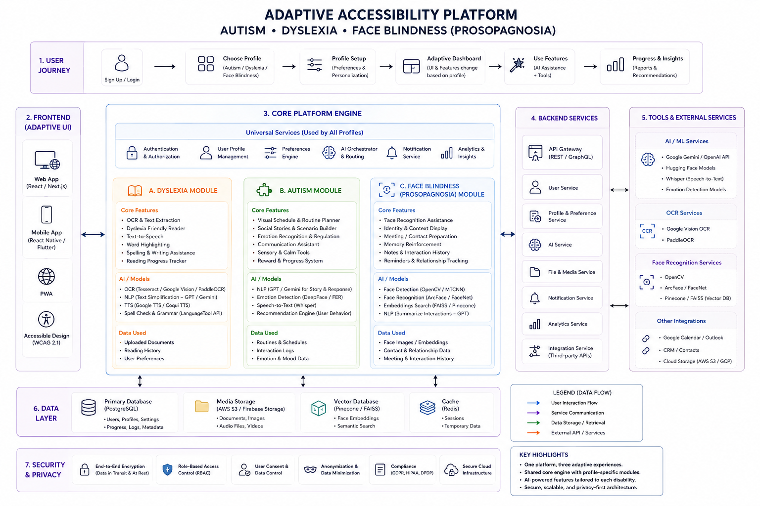
OVERALL ARCHITECTURE

Slide 6
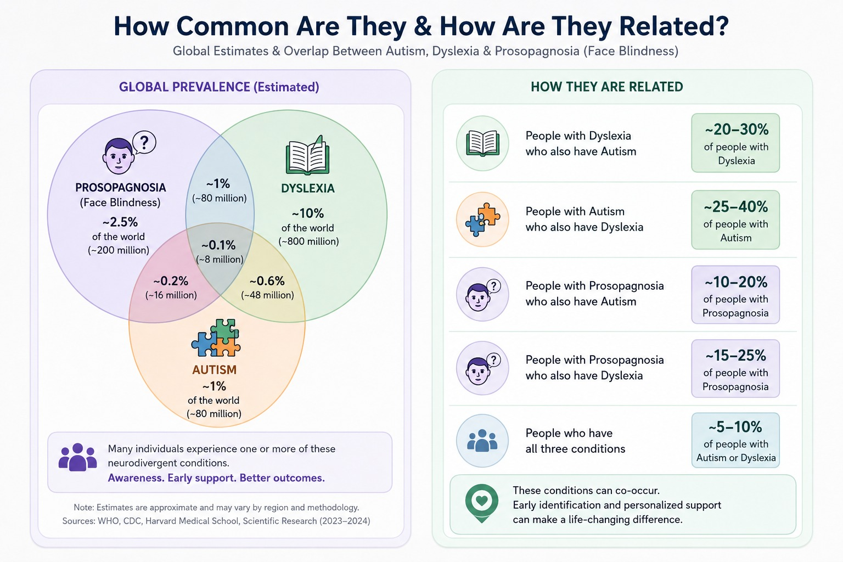

Slide 7
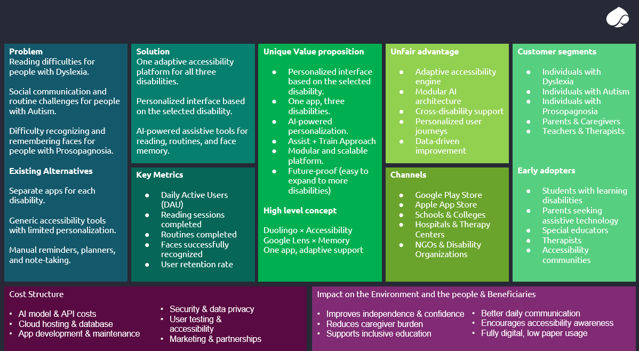
BUSINESS PLAN

